Slide 1
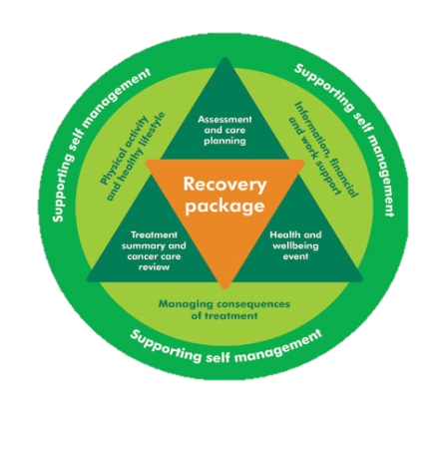
ROLE OF THE MACMILLAN GYNAECOLOGY CLINICAL NURSE SPECIALIST
Gwen Gow
Lesley Harrison
What is a Macmillan Gynaecology Clinical Nurse Specialist?
An experienced nurse who works within the Wirral Gynaecology Team, specialising in the care of patients with disorders affecting the ovaries, uterus, vulva and cervix, which are predominantly cancer related.
Supports patients through diagnostic tests, diagnosis and treatment pathways at WUTH
Works closely with other staff and services within WUTH, Clatterbridge Cancer Centre, Liverpool Women’s Hospital and Wirral Community Services.
Employed by WUTH but adopted by Macmillan Cancer Support to empower people to live with and beyond cancer.
How can we help patients?
Providing information about cancer, its treatment and support
Be a point of contact
Provide information and support to patients, families and carers in a well-timed manner during their journey, acknowledging their main concerns and exploring how these might be managed
Liaising with other healthcare professionals in the hospital or community such as a Social Worker, District Nurse, Dietician, Lymphoedema Nurse.
Signpost to local and national organisations such as Maggies, Macmillan Cancer information and Support Services, EVOC, DWP and others.
Support and empower patients to self manage their condition in the long term future
How can you contact us?
Gwen Gow
0151 604 7556
Gweneth.gow@nhs.net
Lesley Harrison
0151 604 7556
lesleyharrison2@nhs.net

