Slide 1
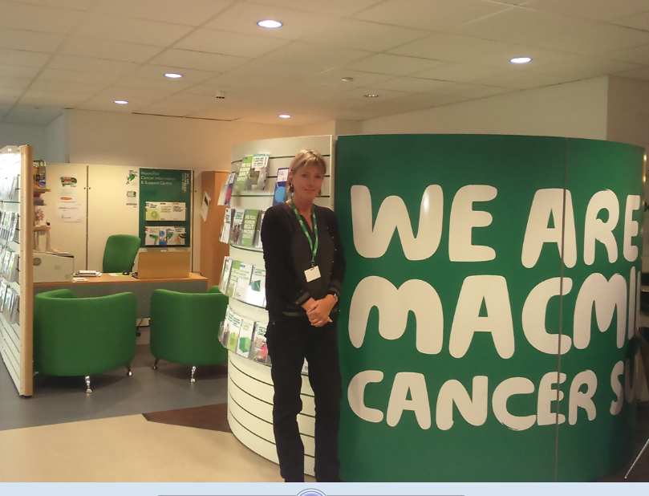
#PROUD TO CARE FOR YOU
Macmillan Cancer Information and Support Centre – Arrowe Park Hospital
A free confidential drop in service for anyone affected by cancer
If you are looking to reduce the risk of developing cancer, have a diagnosis of cancer, are living with the consequences following treatment
Or you are a carer, relative, friend or health care professional
We can help with
Emotional support
Literature on all aspects of living with cancer
The opportunity to discuss treatments, side effects and other cancer related issues
Information and support face to face , by phone and by email
Links to clinical teams
Links and referral to national , local and voluntary services
Signposting to self-help and support groups
Cancer awareness and education
Questions About cancer ?
Come and talk to us
Monday to Friday 10am – 4 pm
Based in the Main Outpatients entrance at Arrowe Park
Telephone 0151 552 1860
Email wih-tr.macmillansupport@nhs.net
Or contact the Macmillan Support line free on 0808 808 00 00

